Slide 1
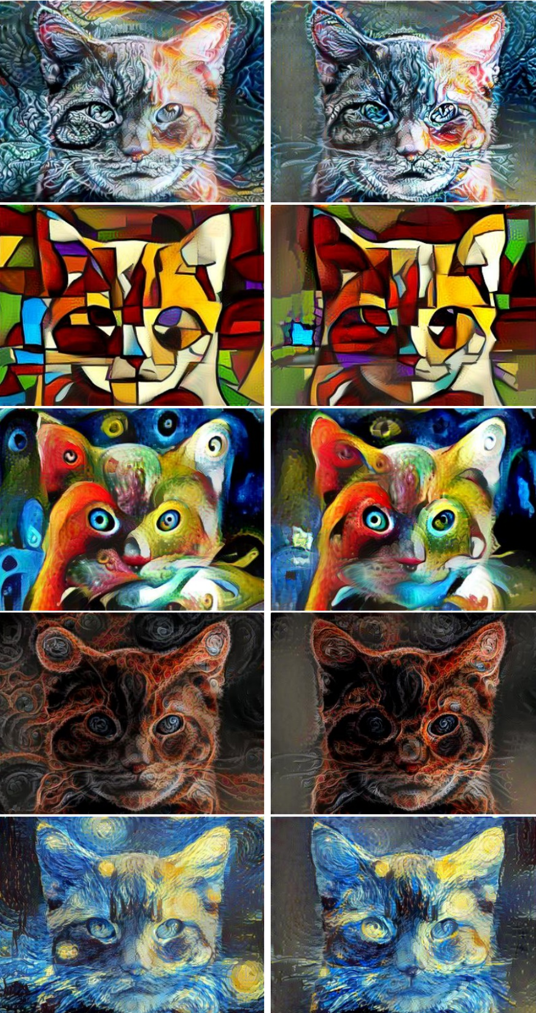
Lesson 8
Artistic applications of CNNs

Slide 2
Getting acquainted
Meet your team mates
Feel free to swap seats if you know people here already
Create a Discourse group
Say hi!
Tell: what are you hoping to get out of the class, and hoping to do with DL?
You will be doing at least one project together
Get to know the forum
Shift-r to reply; Ctrl-enter to send
Replies are instant: join the ‘lesson 8 in-class’ thread now!
You can watch and pin threads
Try creating a thread for your area of interest, for ongoing discussion
We will have study groups at USF – starting this Friday 12-5p 5th floor
But feel free to create geographic-specific study groups or weekend groups too

Slide 3
Join the discussion!

Slide 4
Some logistics
Doors open 5.30p – feel free to come early and find a study buddy
Video is posted immediately after class to forum thread
You can join class remotely up to 2 times if you have to
Please ask questions – in person, or through forums
All files can be downloaded from http://www.platform.ai/part2/

Slide 5
What we’ve learnt so far
Transfer Learning
Differentiable layers
Architecture design
Handling over-fitting
Embeddings

Slide 6
Stacks of differentiable non-linear functions with lots of parameters solve nearly any predictive modeling problem

Slide 7
Transfer learning makes nearly everything easier, faster, and more accurate
Replace last layer
Precompute previous output
Fine-tune more layers
Conv layers are slower*
* How should we handle fully convolutional nets?

Slide 8
We can adjust our architecture for the specifics of our dataset and objective
CNNs for fixed-size ordered data
RNNs for sequences
Softmax for categories
Relu for inner activations

Slide 9
Five steps to avoiding overfitting
More data
Data augmentation
Generalizable architectures
Reduce architecture complexity
Regularization

Slide 10
Embeddings allow us to use categorical data too

Slide 11
From python 2 to 3
Python 2
Python 3
Existing tutorials
Existing code
Largely compatible
iPython compatibility
Py2 2020 EOL
Concurrency
String formatting

Slide 12
From Theano to Tensorflow
Theano
Tensorflow
Simple API
Fewer new concepts
No new ecosystem
ML toolkit
Debugger & profiler
XLA
TF Serving & Cloud ML
Mobile

Slide 13
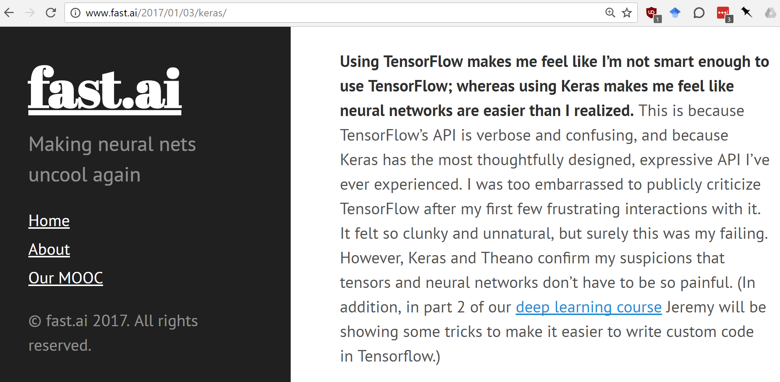

Slide 14
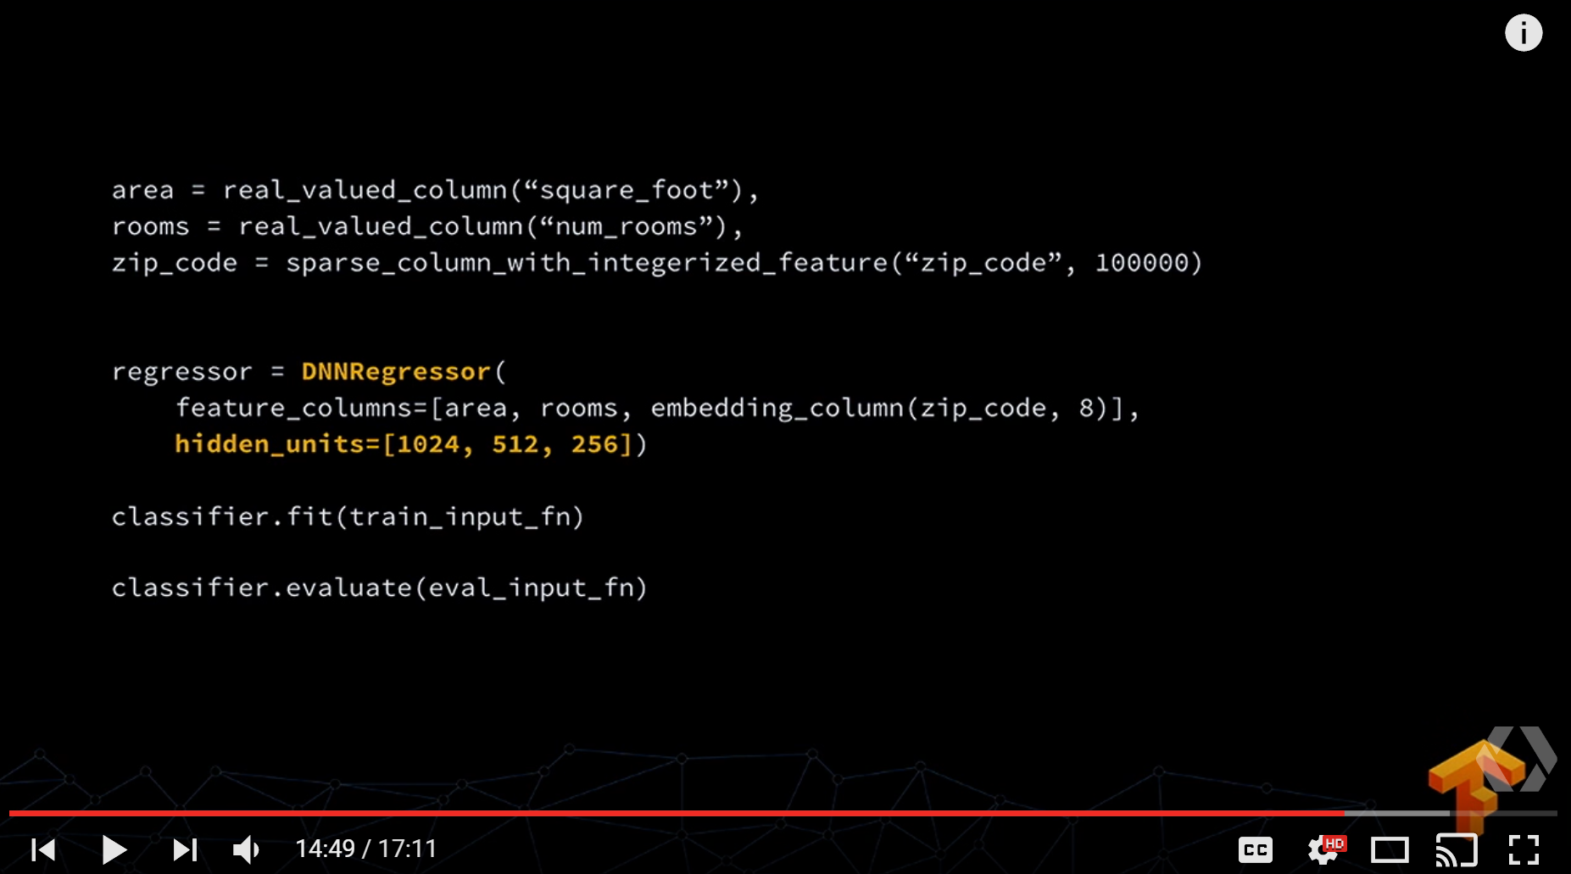

Slide 21
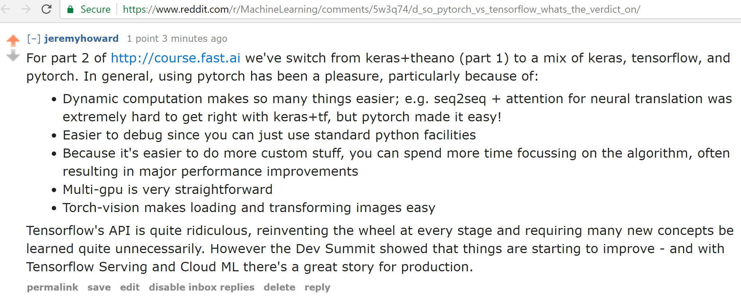
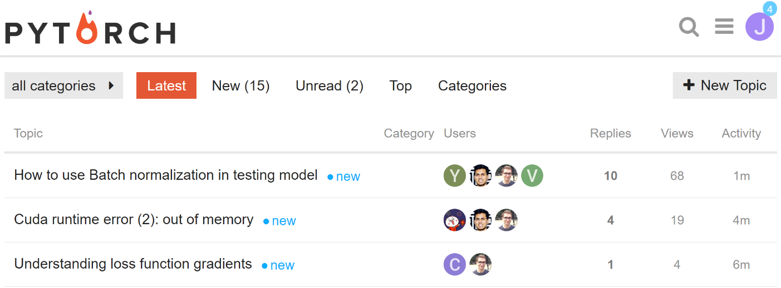
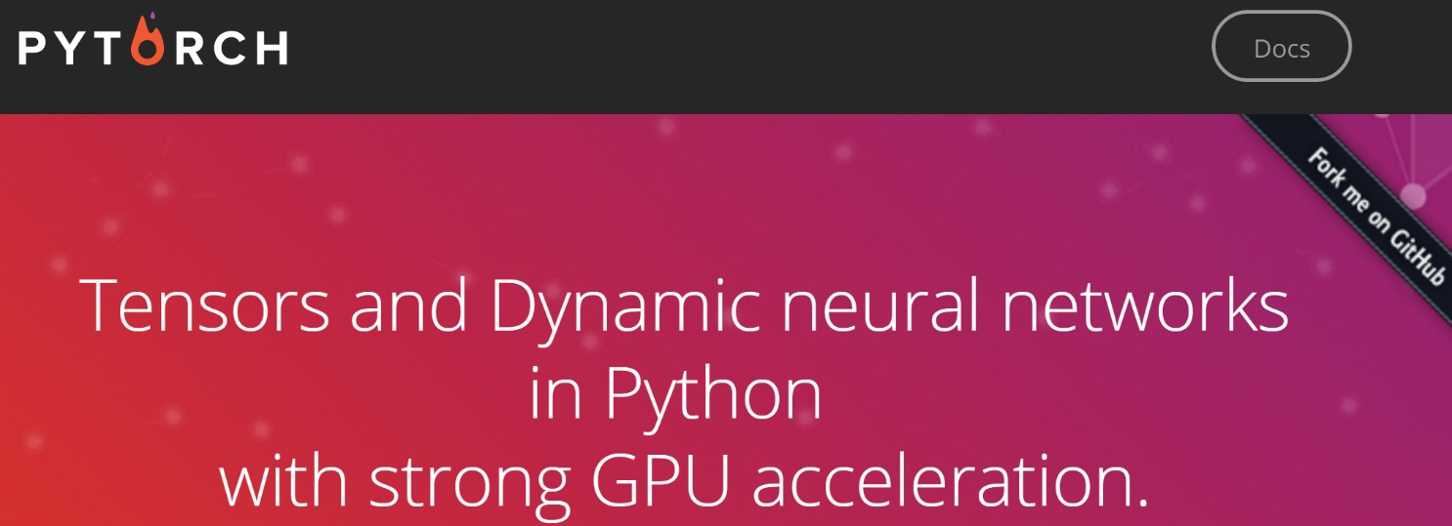

Slide 22
From part 1 “best practices” to part 2 “new directions”
Code samples online nearly always have problems
Few if any existing libraries
Much customization often required
Need to understand python well (e.g. classes)
Each lesson will be incomplete – ideas to explore

Slide 23
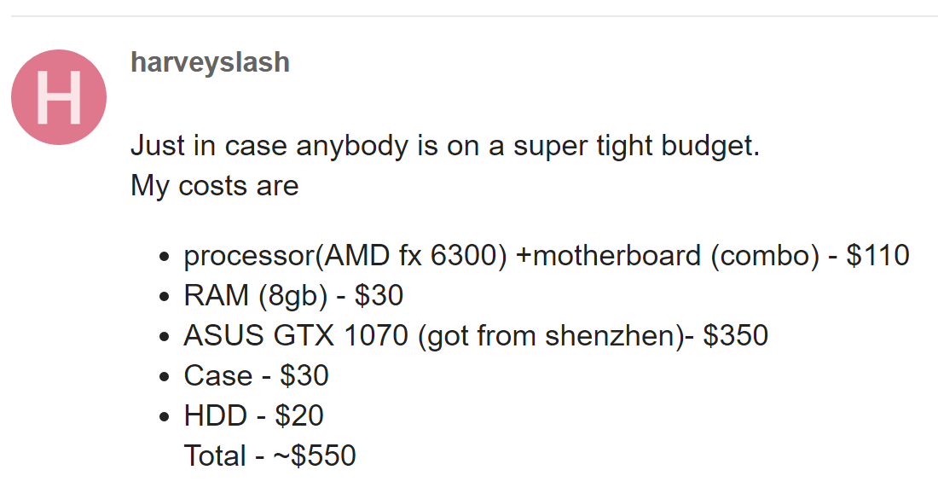
It’s time to build your own box
GPU
Plenty of RAM and good single precision
Titan X Pascal is best, but Maxwell good too (12GB RAM)
CPU and RAM
As much RAM as possible, with room for more
Make sure motherboard supports >=64GB RAM
Storage
Fast SSD for analysis and big disks for data
NVMe drives are amazing! Get the biggest you can afford
GTX 1080 or 1070 also excellent (8GB RAM). Used GTX 980 is a good budget choice
i5 or i7 CPU is fine
Fill up the rest of the space with the largest standard hard-drives you can buy
The rest
pcpartpicker.com is very helpful
Make sure your power supply is more than sufficient.
Ensure you have x16 PCI lanes for your GPUs
Dual GPUs let you continue to prototype whilst running an experiment
A store like centralcomputers.com can put it together for you
http://forums.fast.ai/t/making-your-own-server/174

Slide 24
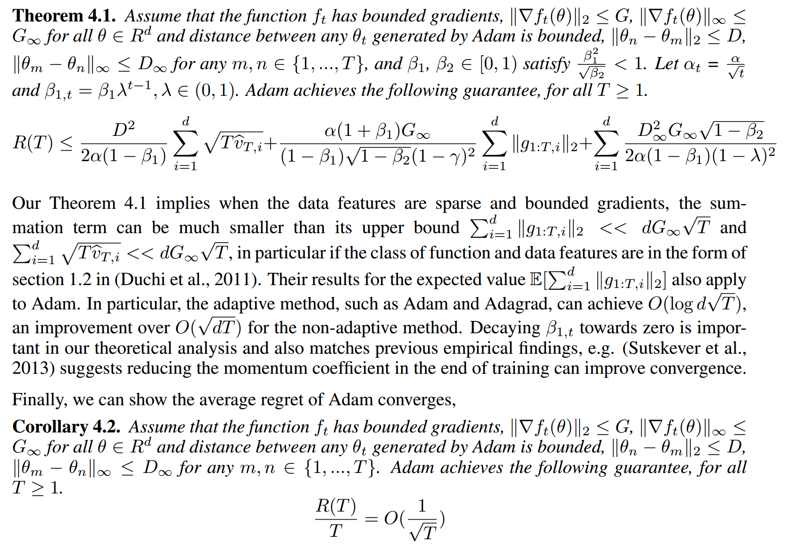
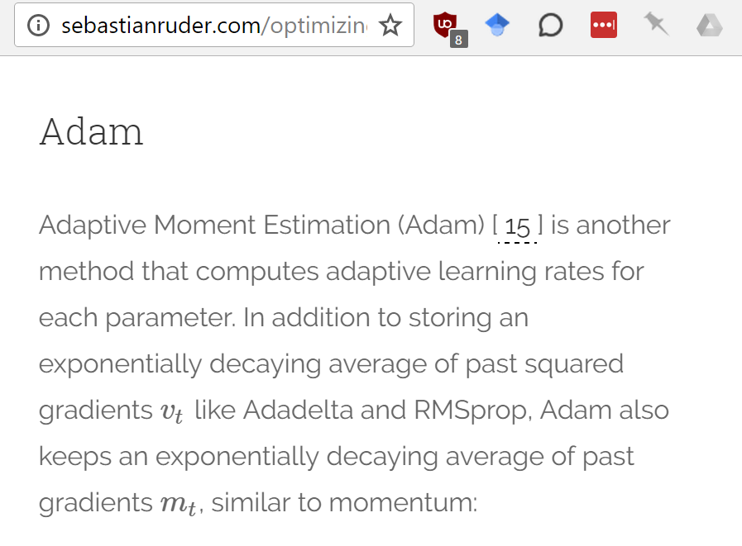
It’s time to start reading papers
Even familiar stuff looks complex in a paper!
Papers are important for deep learning beyond the basics, but hard to read
Google for a blog post describing the paper
Learn to pronounce Greek letters

Slide 25
There are many opportunities for you in this class
Your homework will be at the cutting edge
There are few DL practitioners that know what you know now
Experiment lots, especially in your area of expertise
Much of what you find will have not be written about before
Don’t wait to be perfect before you start communicating
If you don’t have a blog, try medium.com
We will feature the best posts on fast.ai

Slide 26
What we’ll study in Part 2
Generative Models
CNNs beyond classification
Segmentation
Super-resolution
NLP beyond classification
Translation
Chatbots (Q&A)
Large data sets
Large images
Lots of data points
Colorization
Artistic style
Semi-supervised
Captioning
Large outputs
Other data types
Structured
Time series

Slide 27
Artistic style method #1 – the general idea

Slide 28
A more general approach to image→image models

Slide 29
Three approaches to downsampling

Slide 30
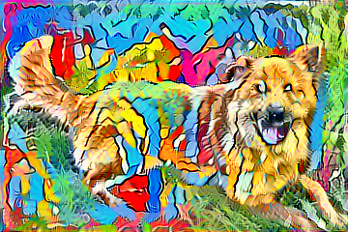
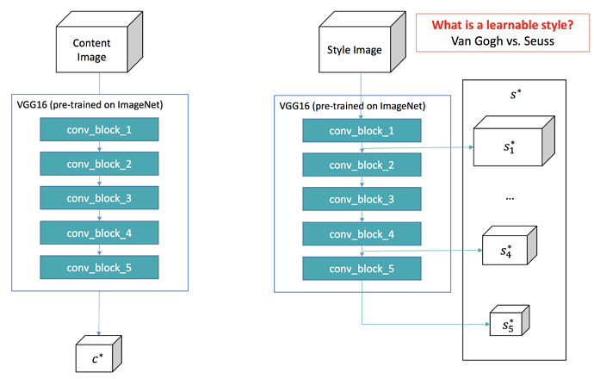
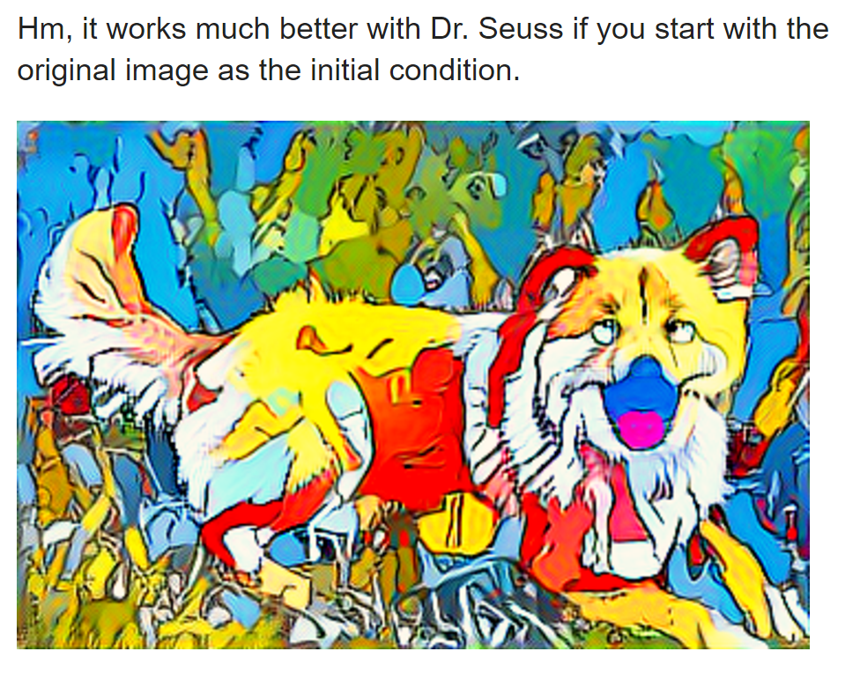
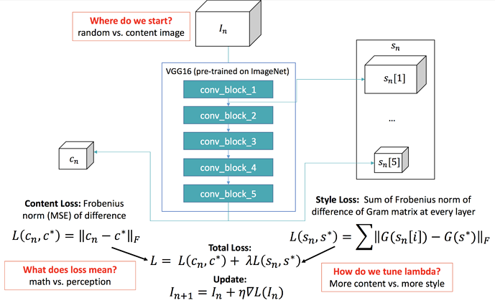

Slide 31
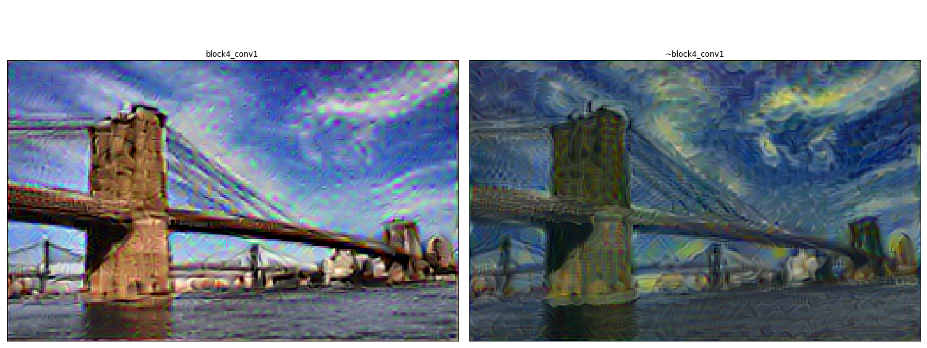

Slide 32
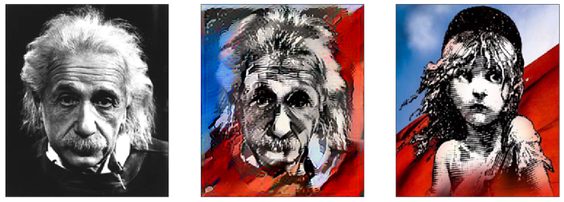
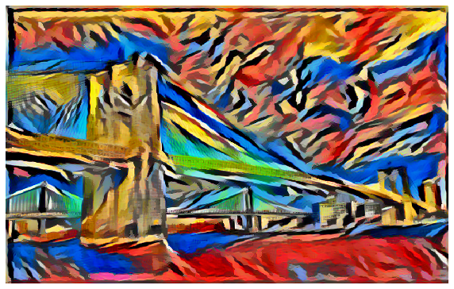

Slide 33
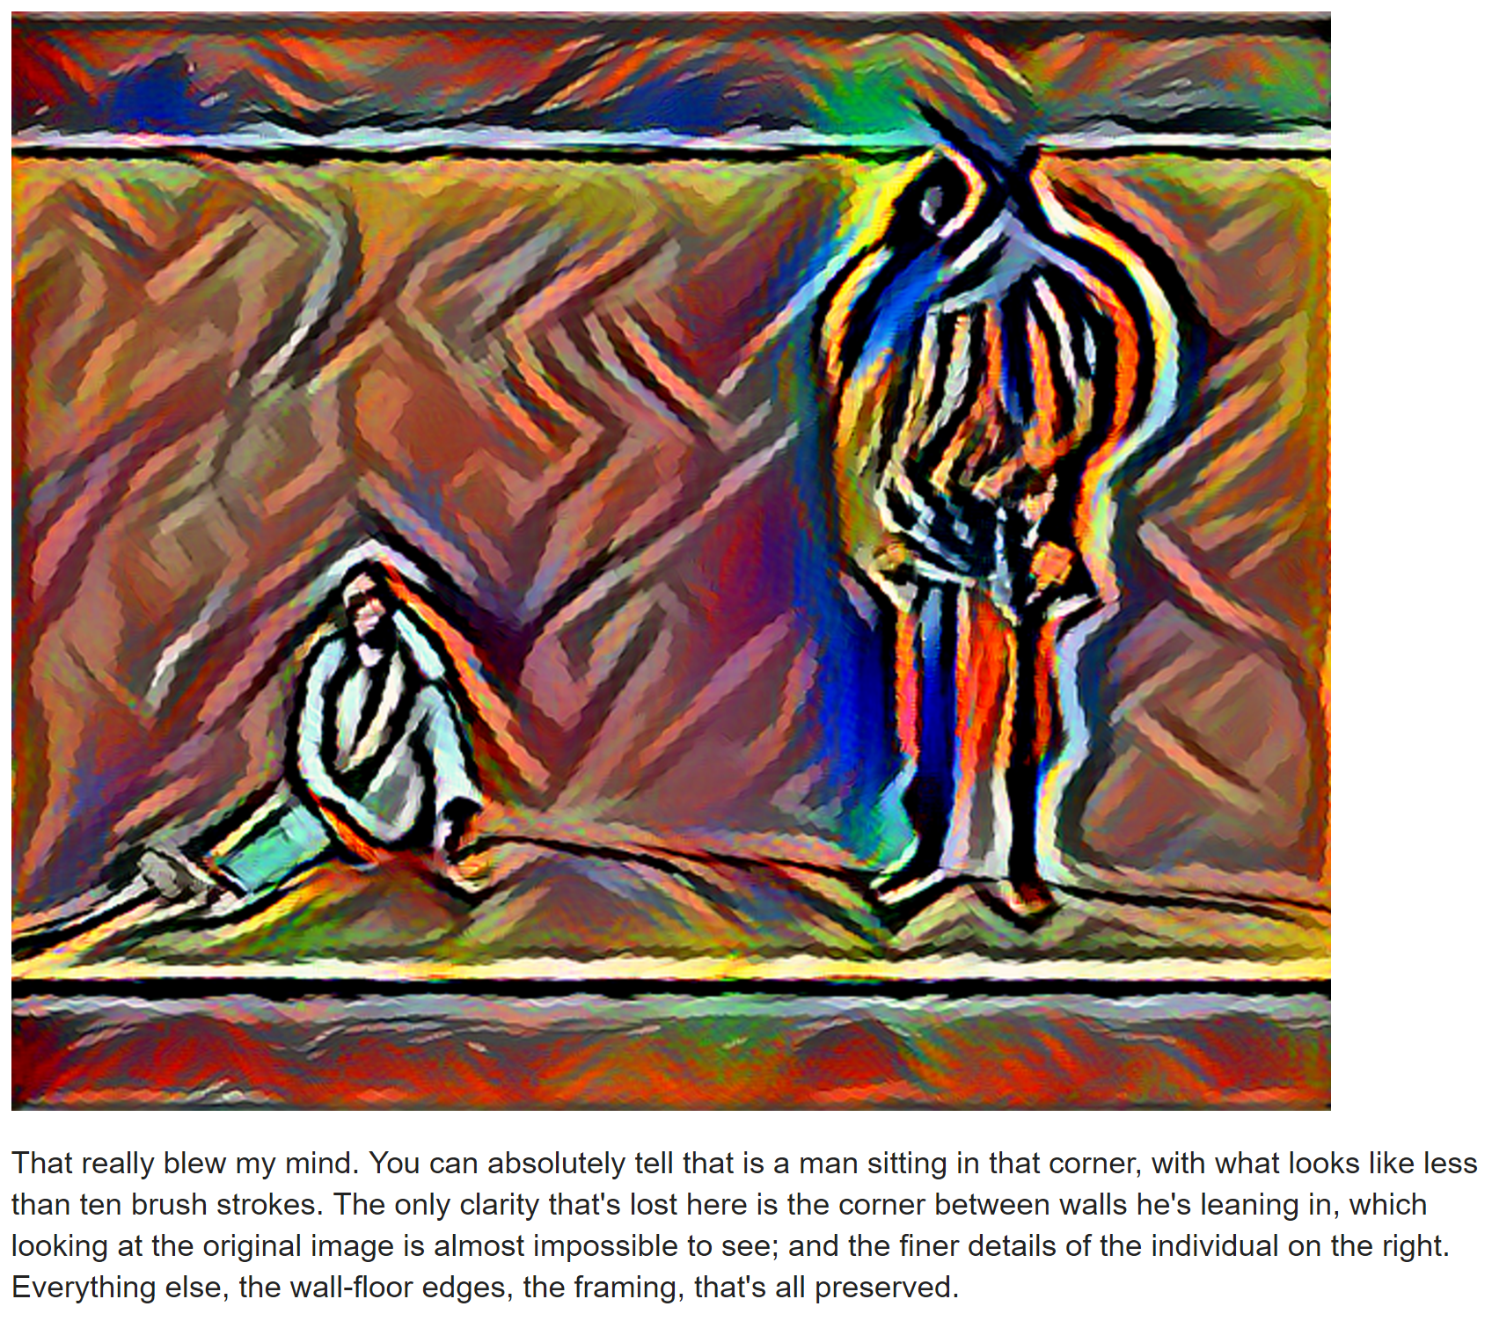

Slide 34
Ideas from Keras Implementation of Neural Style Transfer https://github.com/titu1994/Neural-Style-Transfer
Uses conv5_2 output to measure content loss. Original paper uses conv4_2
Initial image used for image is the base image (instead of random noise image)
By default MaxPooling is used, since if offers sharper images, but AveragePooling applies the style better in some cases
Style weight scaling
Rescaling of image to original dimensions, using lossy upscaling present
Maintain aspect ratio of intermediate and final stage images, using lossy upscaling
Improvements in INetwork
Improvement 3.1: Geometric Layer weight adjustment for Style inference
Improvement 3.2: Using all layers of VGG-16 for style inference
Improvement 3.3: Activation Shift of gram matrix
Improvement 3.5: Correlation Chain

Slide 35
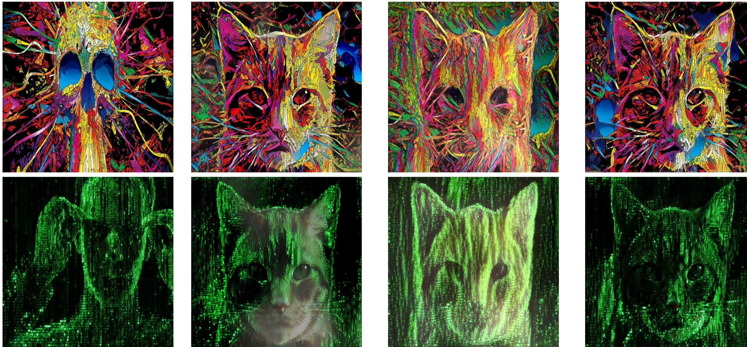
Improving the Neural Algorithm of Artistic Style https://arxiv.org/abs/1605.04603

Slide 36
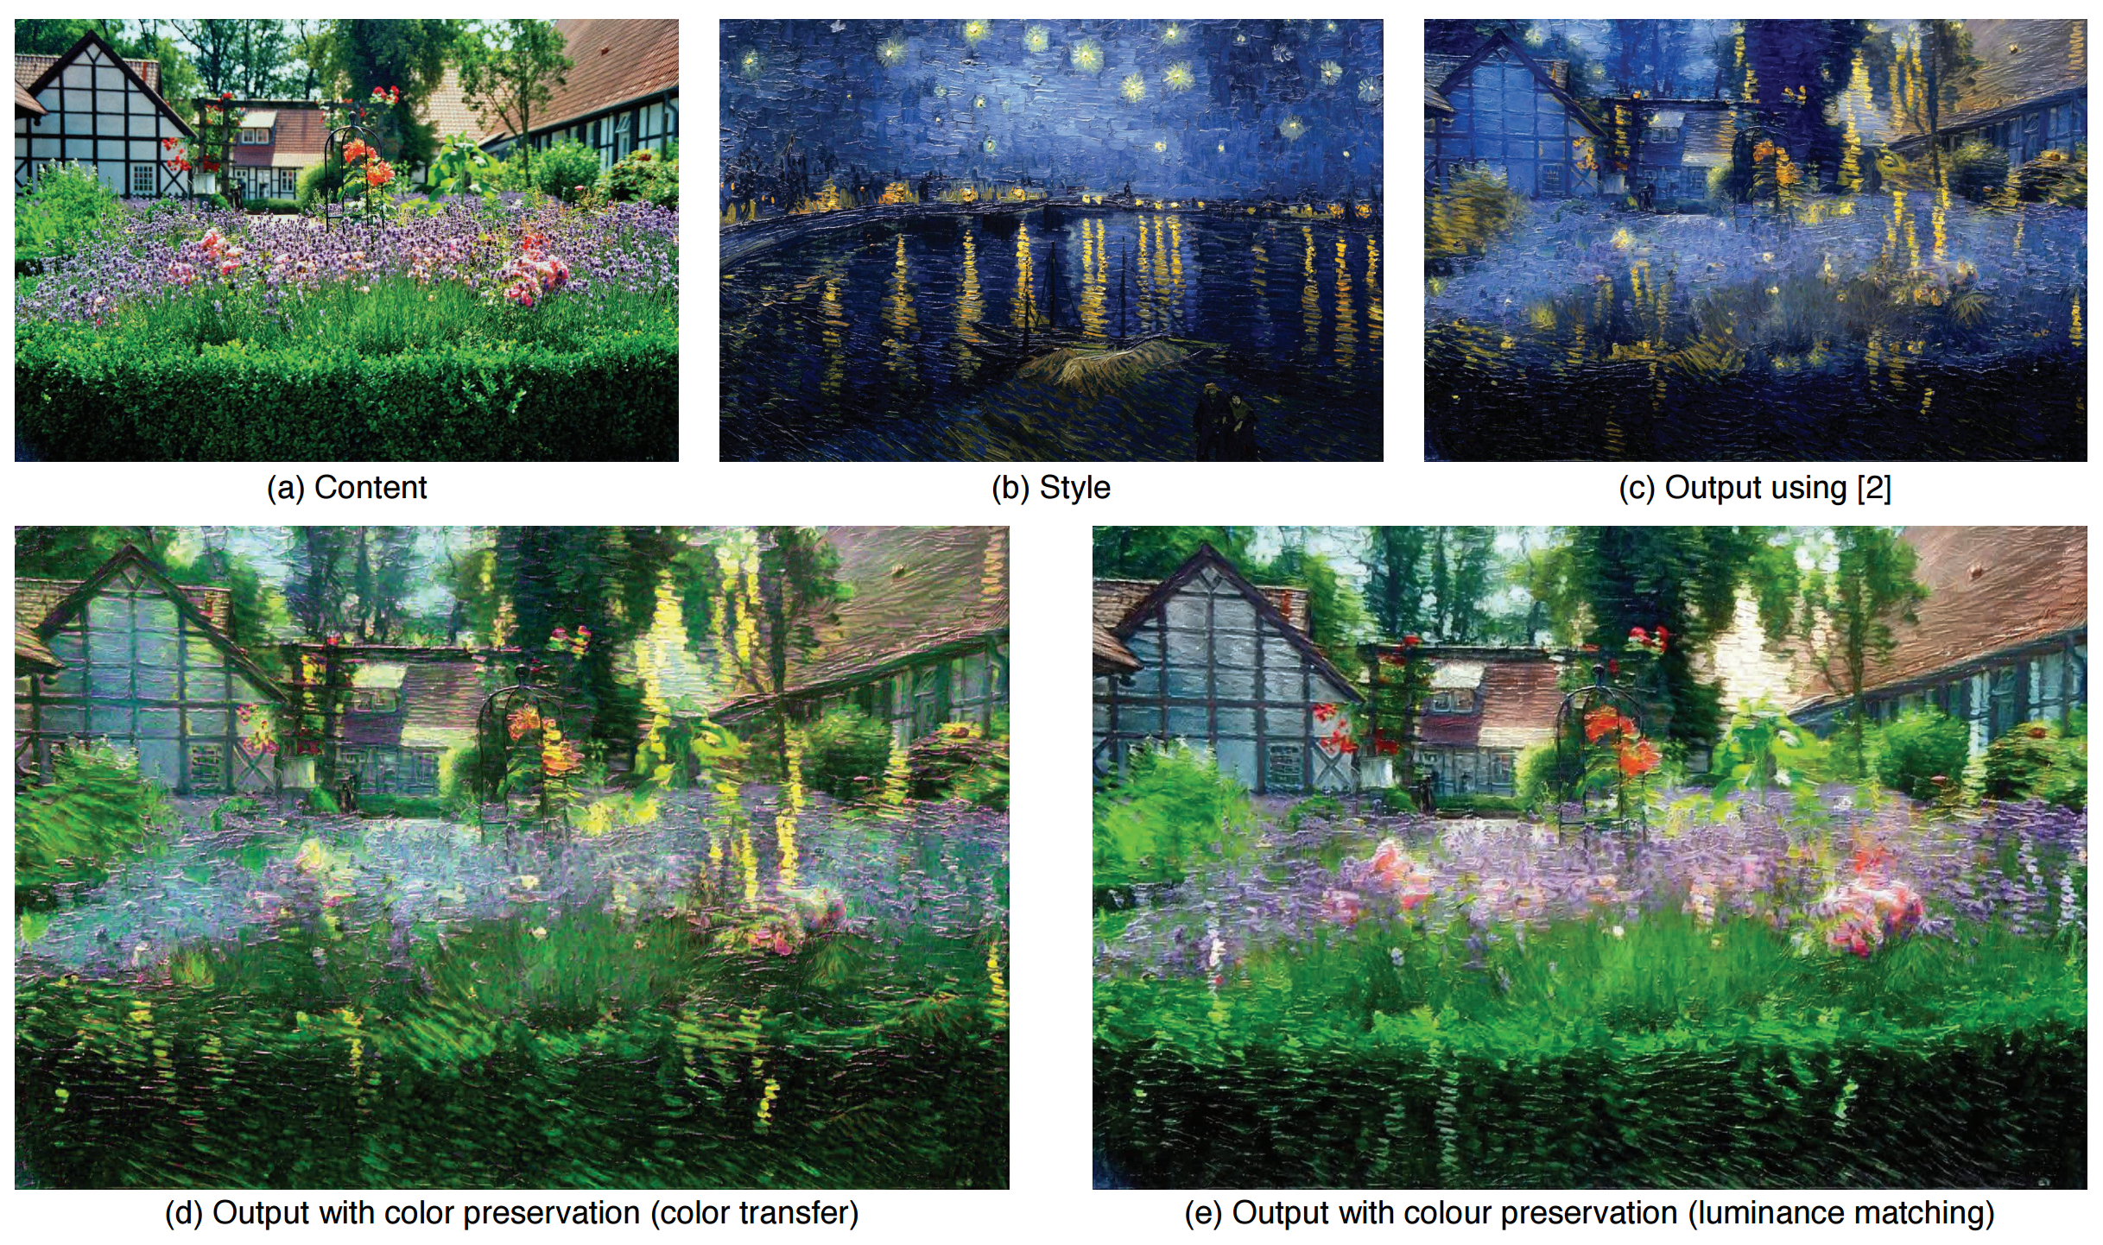

Slide 37
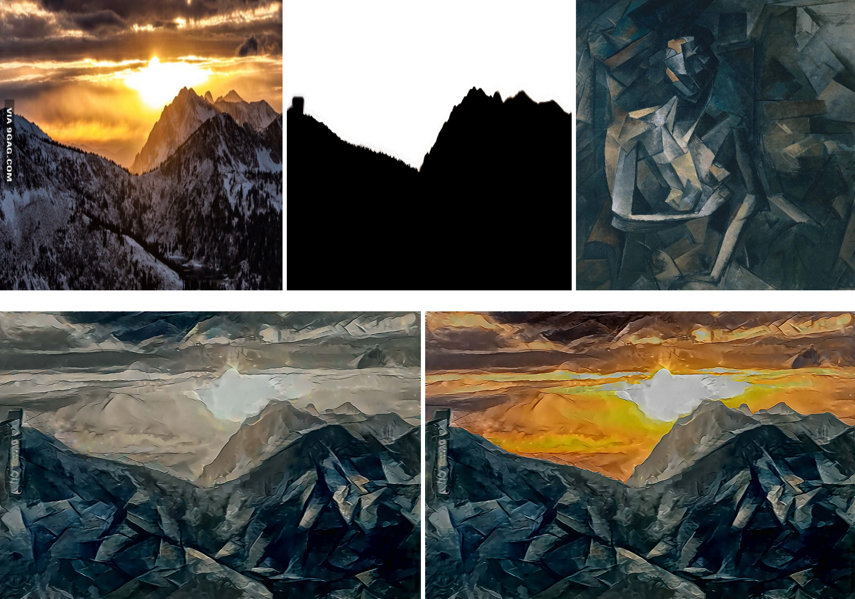

Slide 38
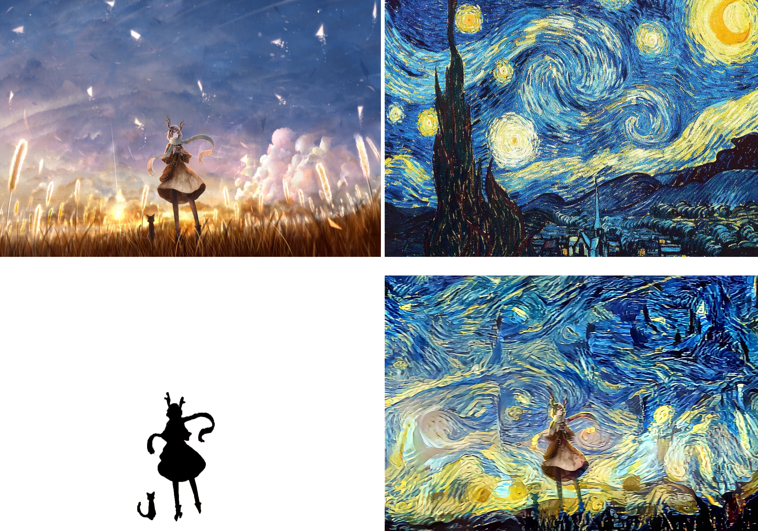

Slide 39
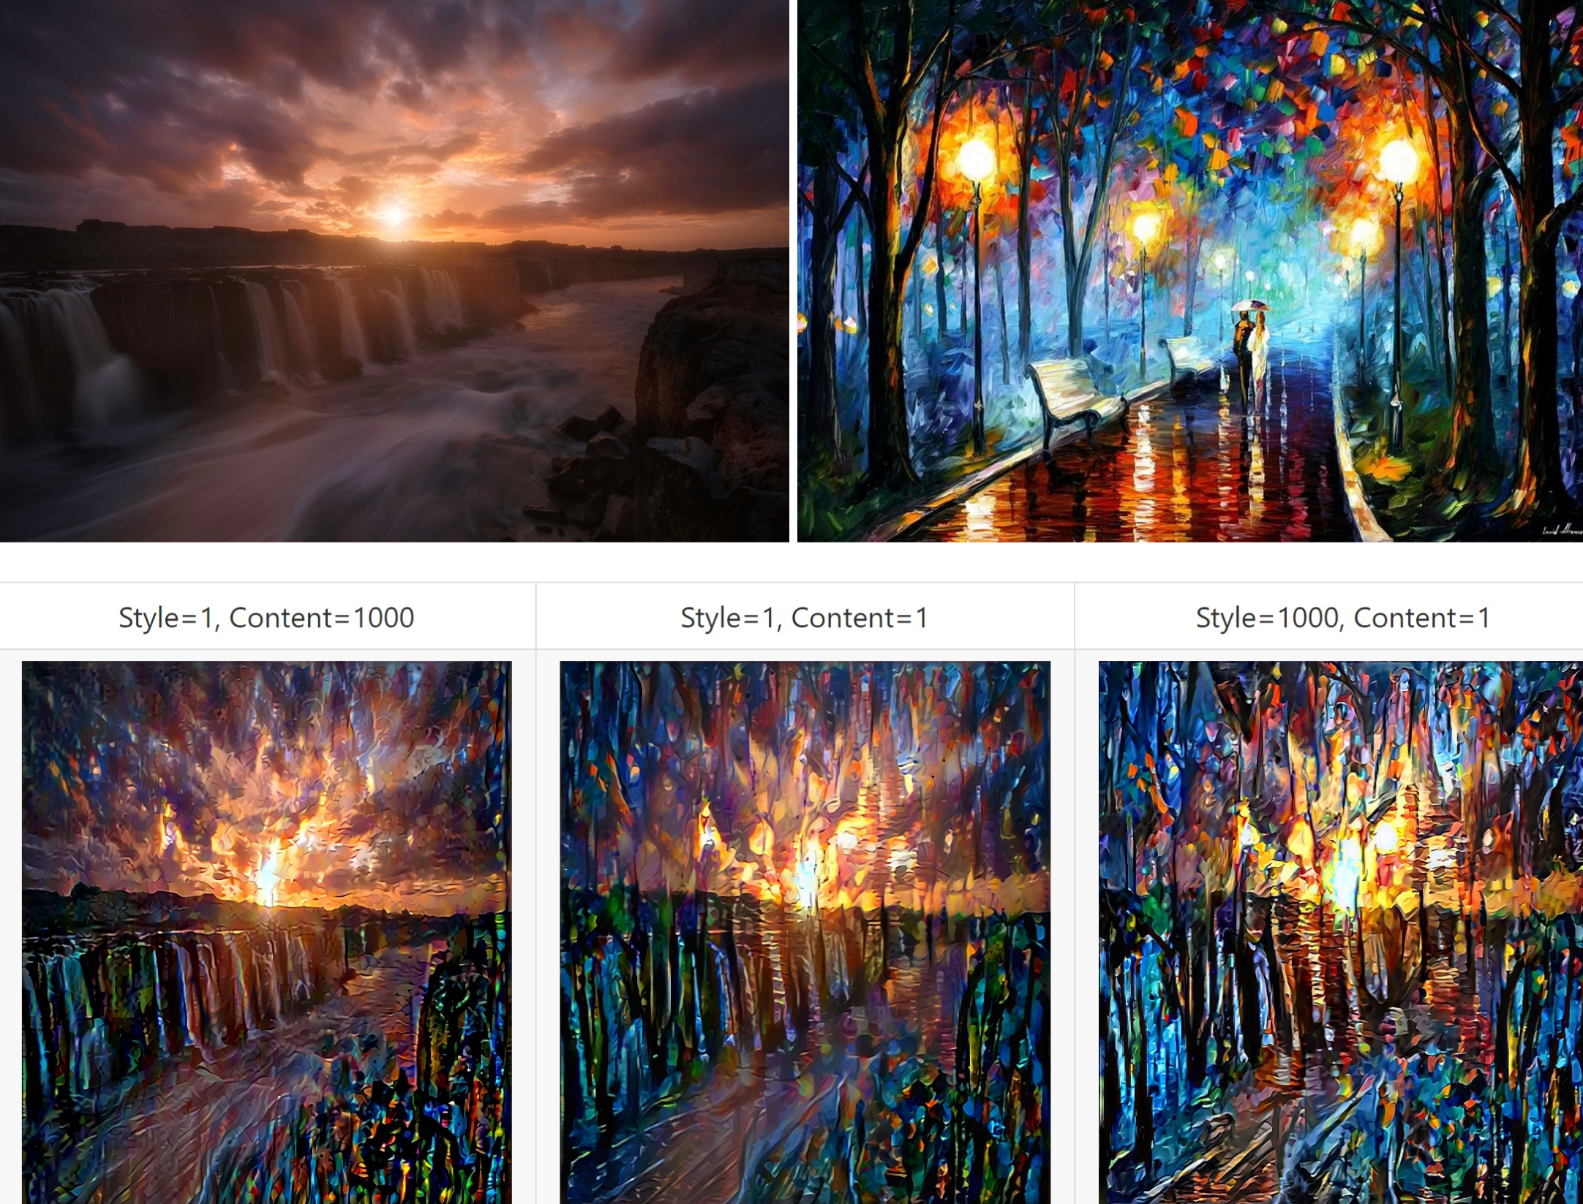

Slide 40
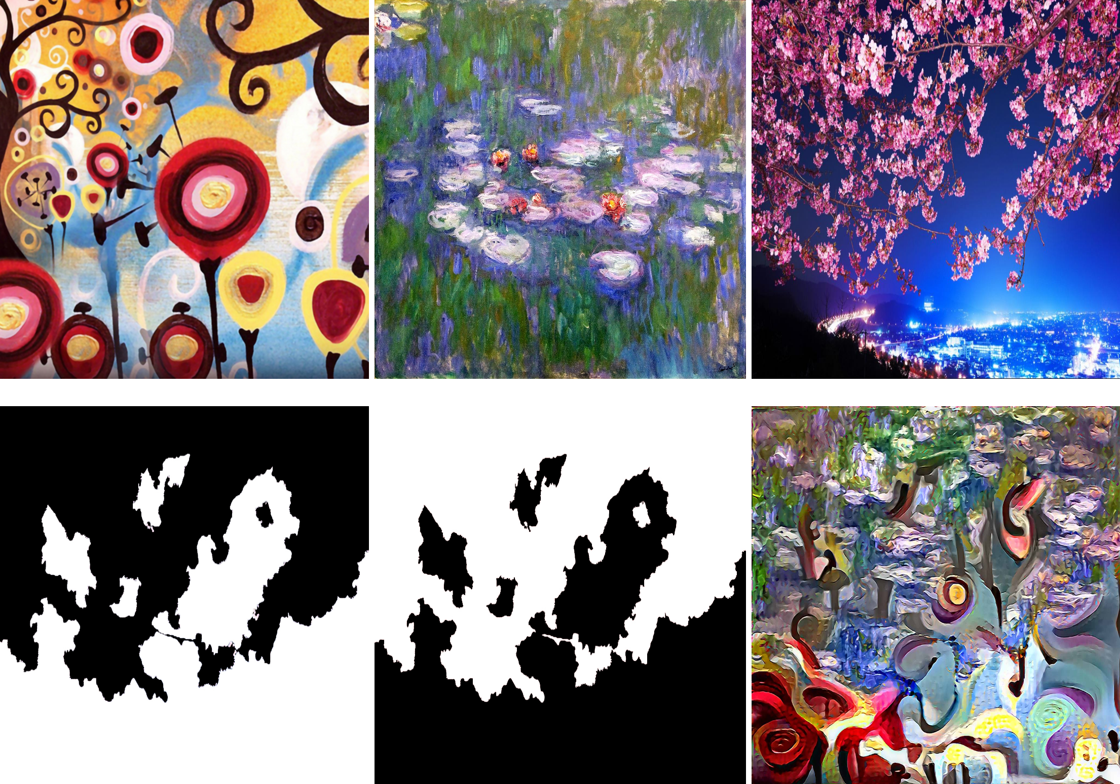

Slide 41
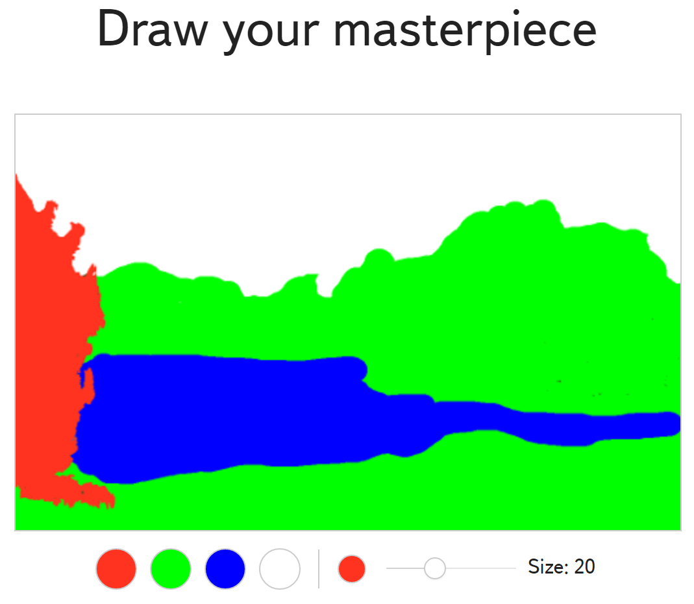
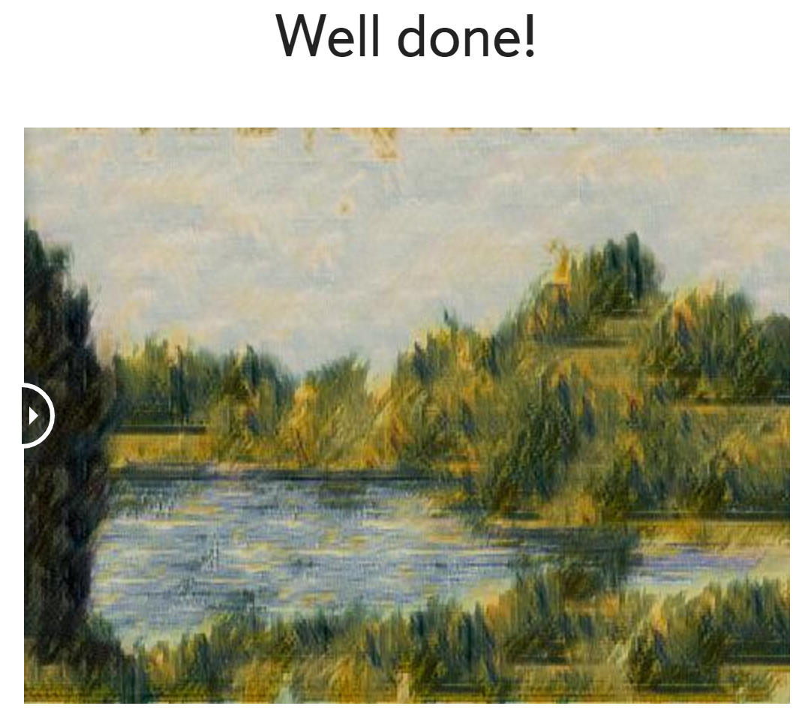
https://arxiv.org/abs/1603.03417

Slide 42
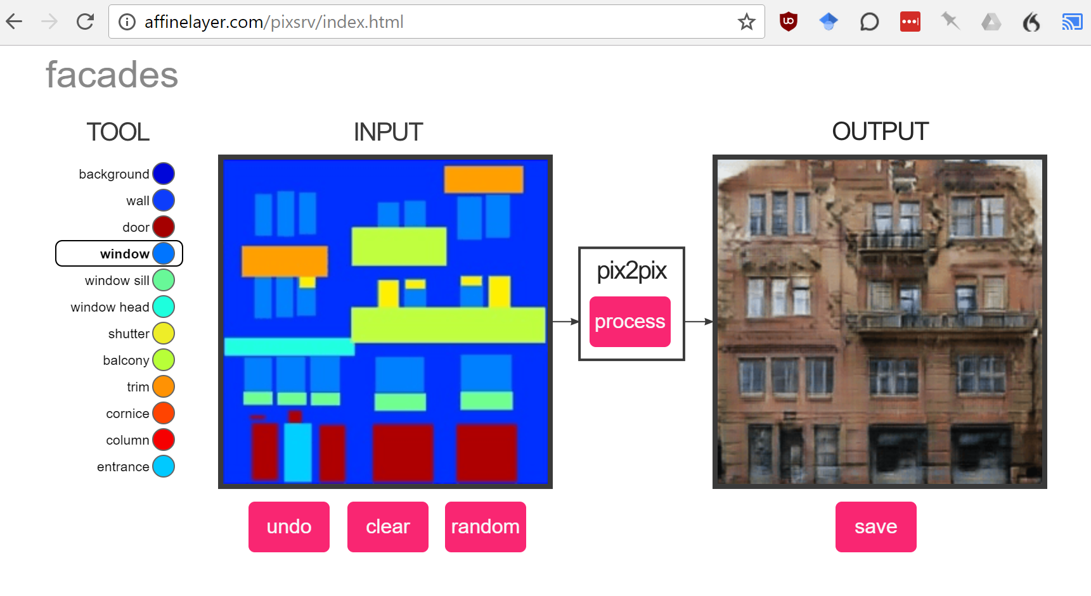

Slide 43
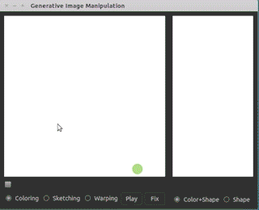
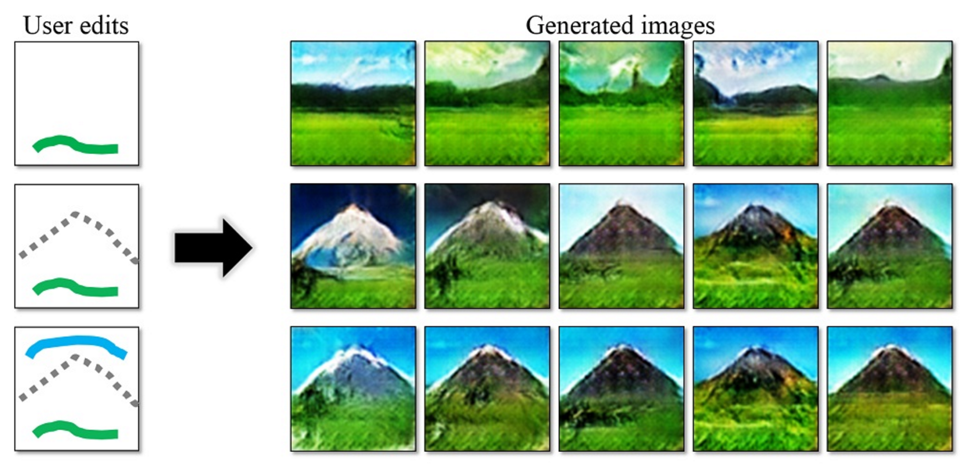

Slide 44
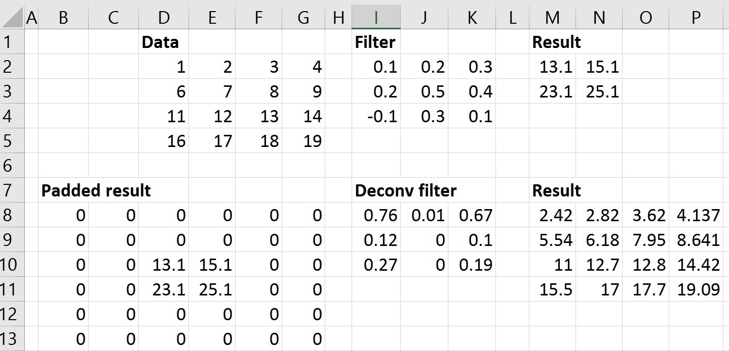
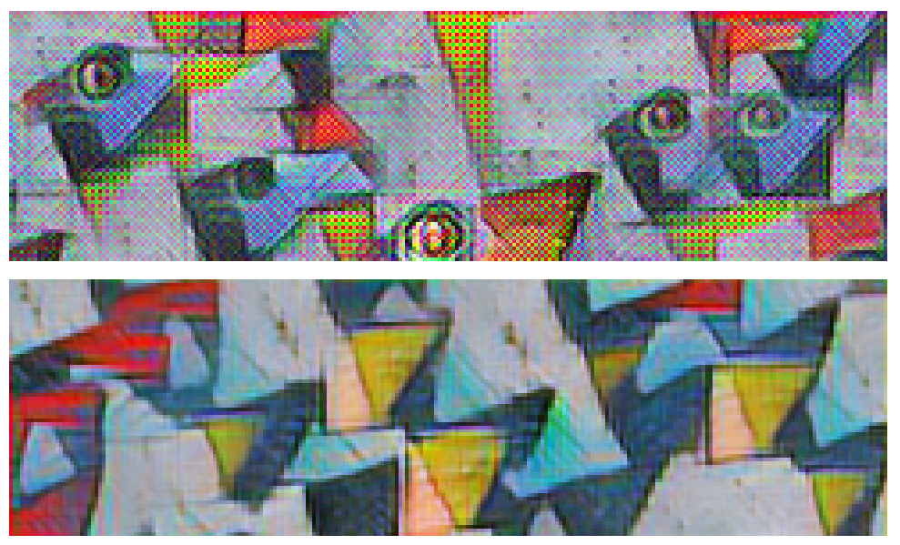
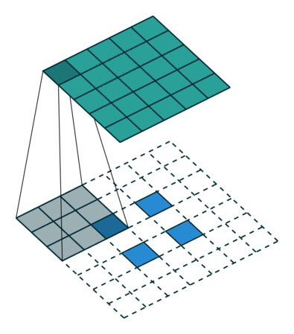
Two approaches to up-sampling
Deconvolution
Resizing (Nearest Neighbors)
http://deeplearning.net/software/theano_versions/dev/tutorial/conv_arithmetic.html
http://distill.pub/2016/deconv-checkerboard/

