Slide 1
Lesson 11
Practical Deep Learning For Coders

Slide 4
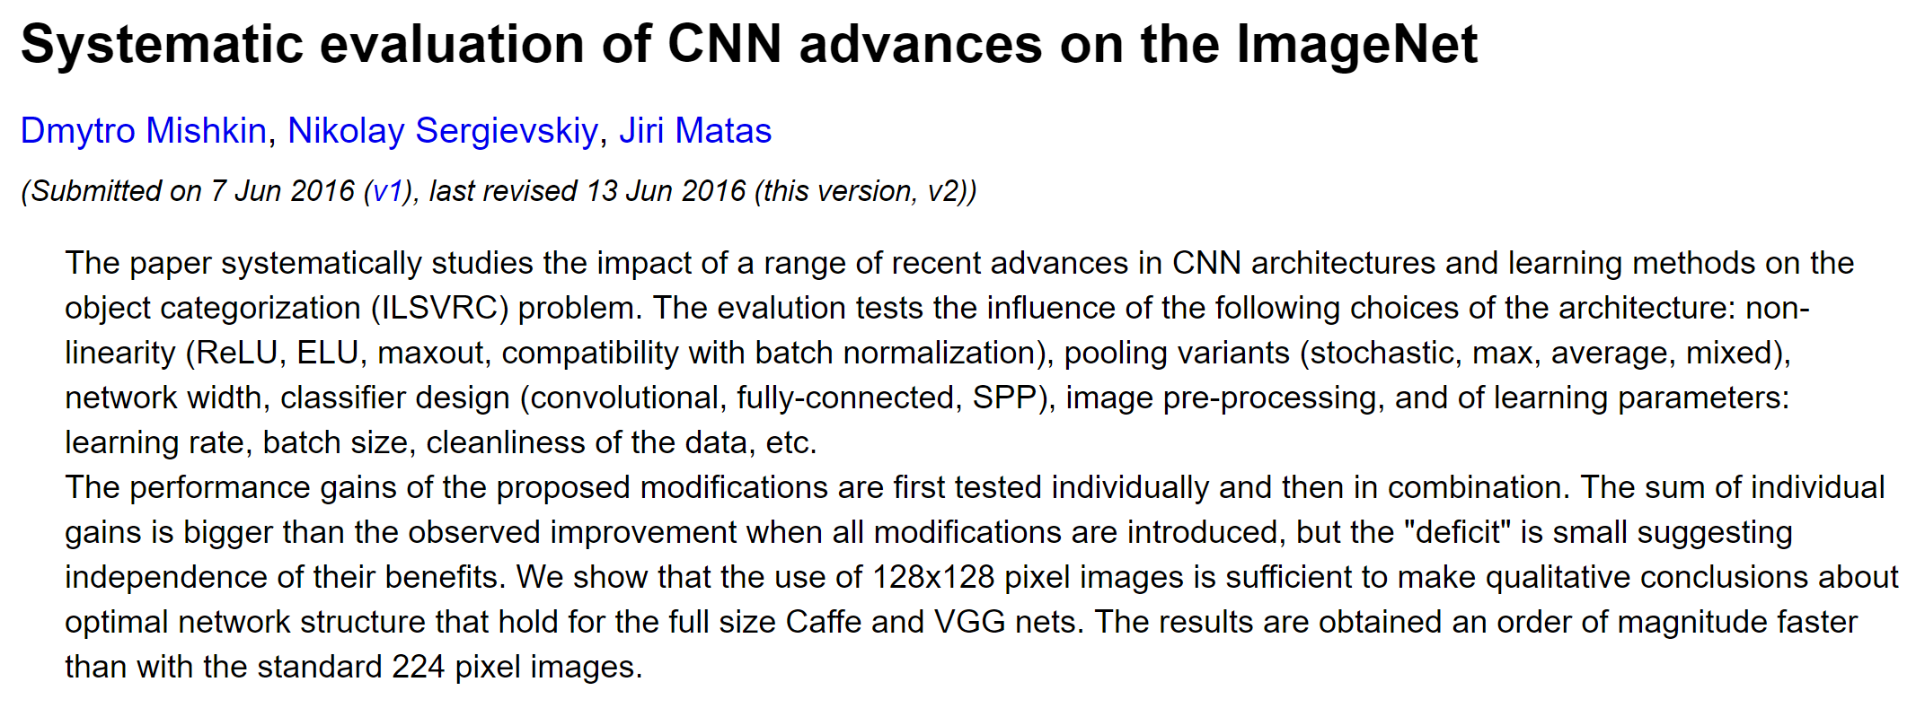

Slide 5
Comparing architectures can be done on a smaller model – 10x faster

Slide 6
ELU better than ReLU, and even better if using maxout for FC layers
Double complexity
Maxout:
x1 = Convolution2D(…)(x)
x2 = Convolution2D(…)(x)
conv10 = merge([x1, x2], 'max', concat_axis = 1)

Slide 7
Linear learning rate annealing works well

Slide 8
Learnable colors transformations is a simple and effective trick

Slide 9
Batchnorm effectiveness depends on architecture

Slide 10
Remove final max pooling, and replace FC layers with convolutional→average pooling

Slide 11
Changes to the batch size should be combined with proportional changes to learning rate

Slide 12
Relationship between dataset size and accuracy is non-linear

Slide 13
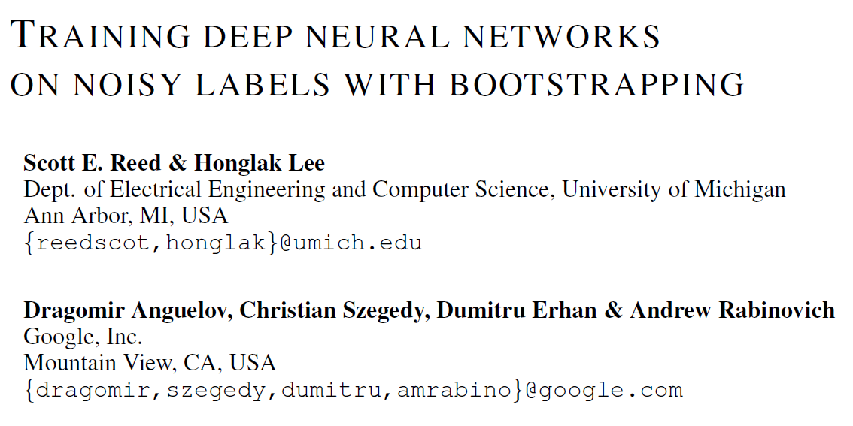
Impact of noisy labels can be avoided

Slide 14
Combining these results makes VGG highly competitive
Impact

Slide 15
Still lots to be done…
Data augmentation
Zooming and cropping
Skip connections
Initialization methods
Depth
Impact on resnet
Most important: transfer learning effectiveness
E.g.: are FC layers better for transfer learning?

Slide 16
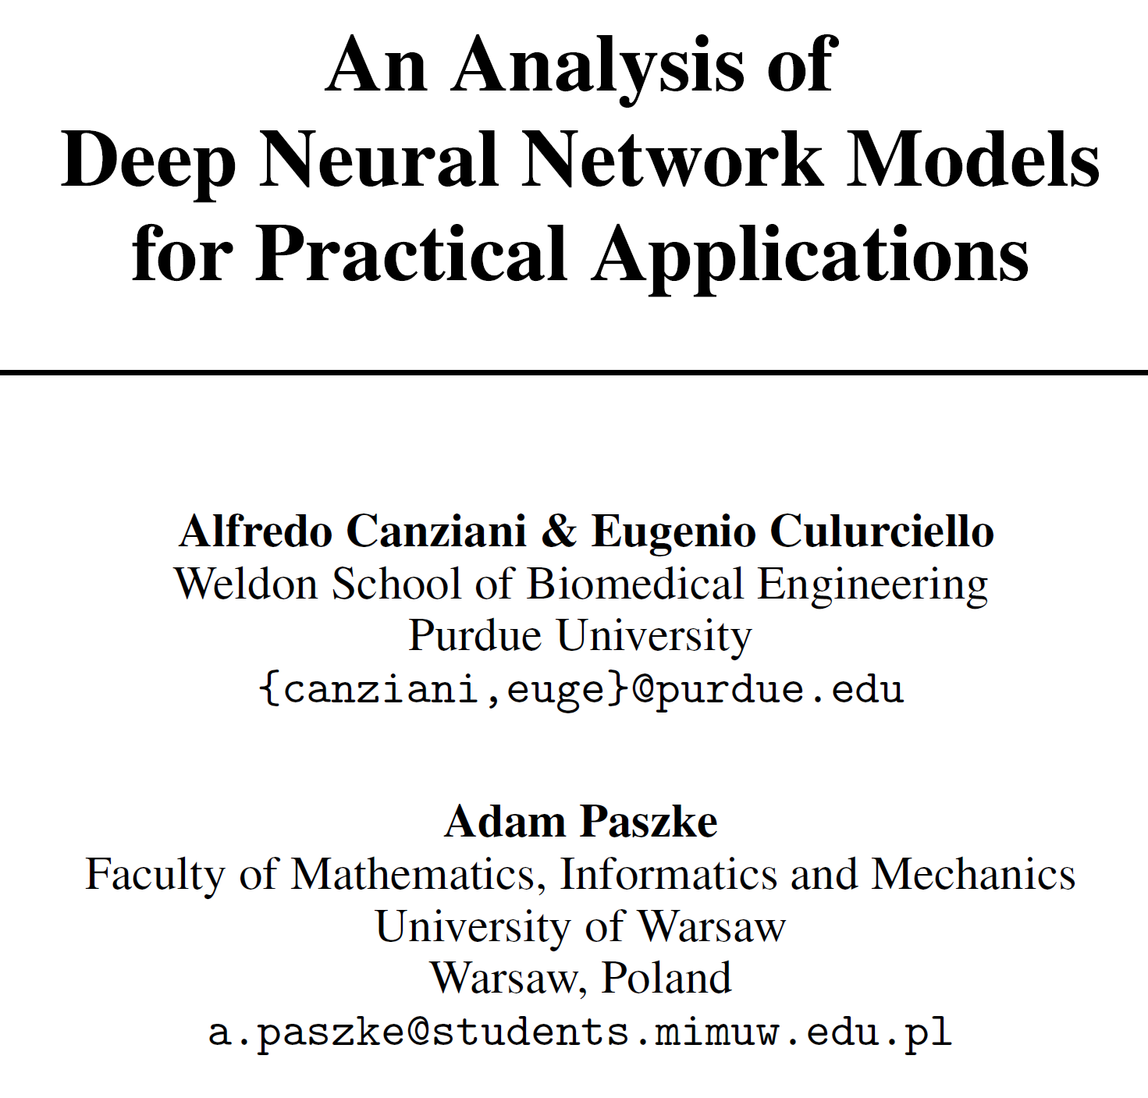
Modern architectures are both more accurate and more efficient (memory and FLOPs)

Slide 18
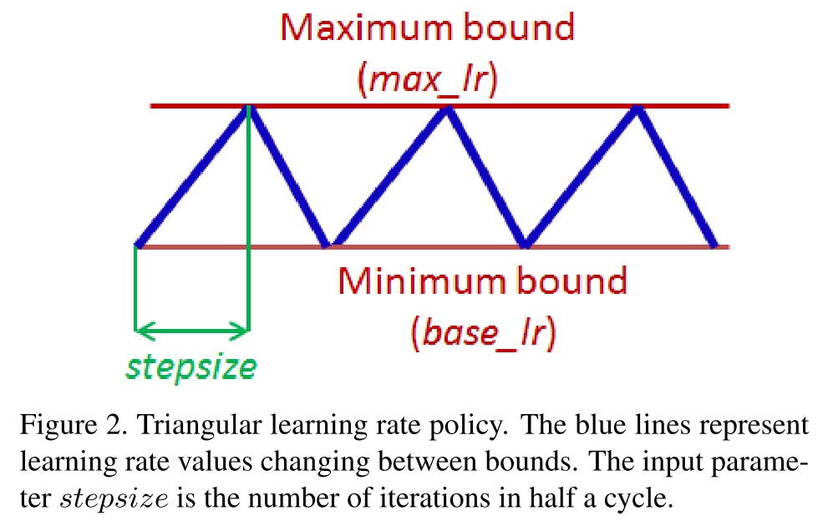
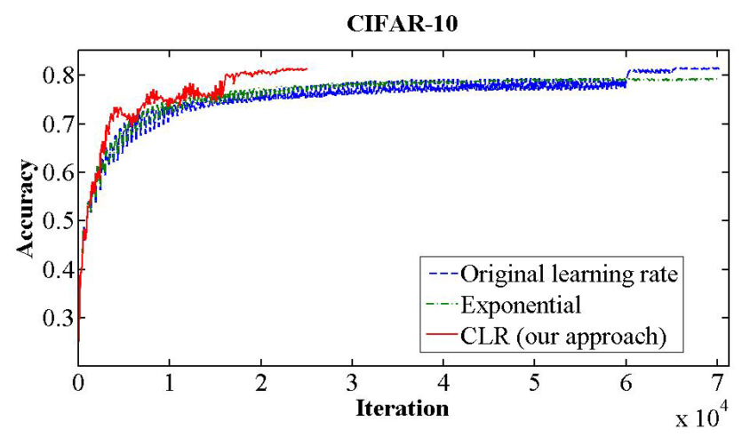

Slide 19
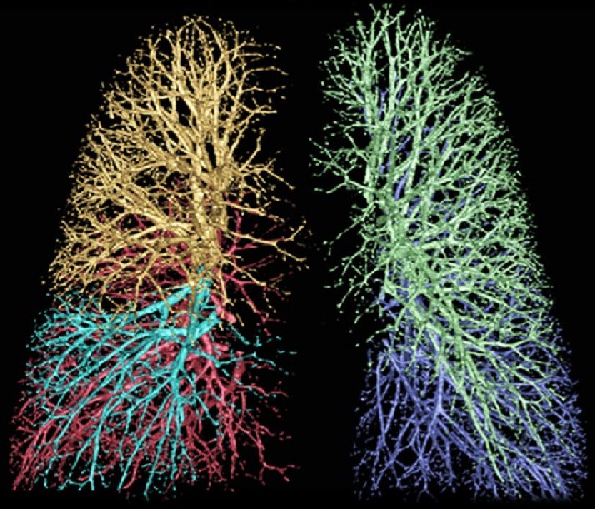

Slide 20
